Slide 1

CarePilot
Conversational analytics & paperwork relief for clinicians
Plug-in for EHR via SMART on FHIR

Slide 3
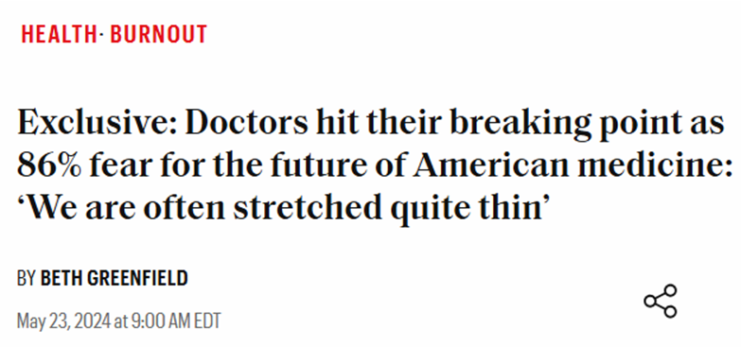

Slide 4
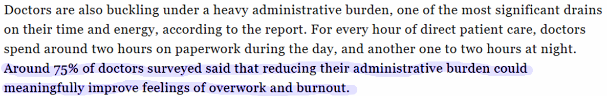

Slide 5
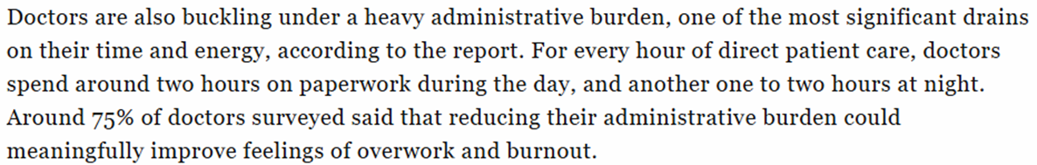
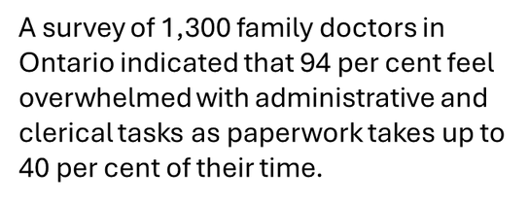

Slide 6
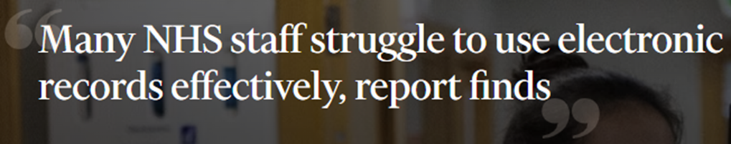


Slide 7
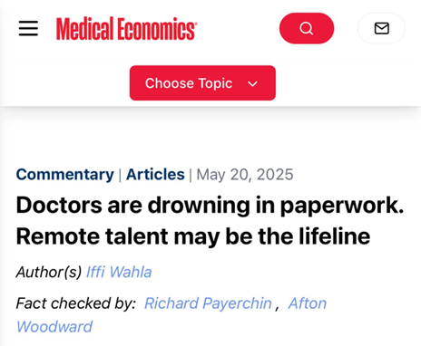

Slide 8
“Medicine isn’t short of skill; it’s short of time.”

Slide 9
CarePilot
Our Solution
We return clinicians minutes by removing two time sinks: finding data and re-typing it.
Answers patient-level questions
Runs cohort queries over hospital data
Pre-fills forms to cut clicks
fewer context switches
no tab hunting
seconds-to-answer
FHIR-enabled queries for real-time EHR access
Turns a half-day question into a 1–2 minute query
Right inside the EHR frame
auto-fills IDs, dates, meds & more, saving precious time
more consistent docs

Slide 10
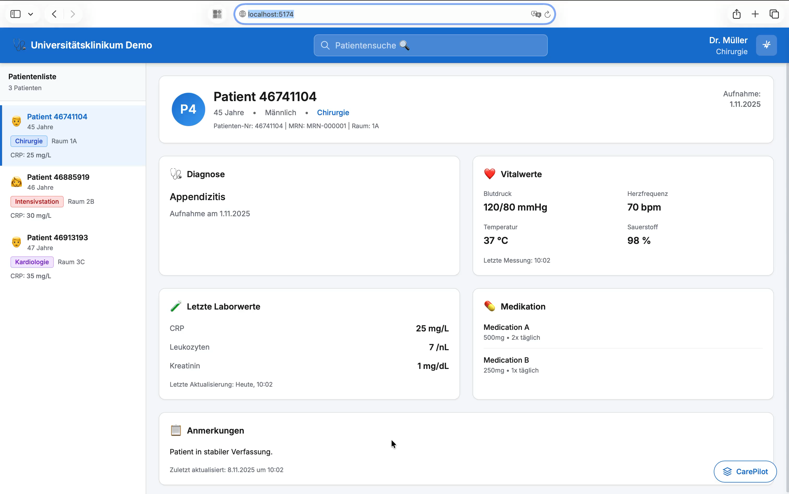

Slide 11

Partial prefill: small per form, big at scale
CarePilot
Fall event report
~9.3 min
Discharge summary
~ 26 min
D-Arzt, F1000
~10–20 min
Medication error report
~7–12 min
Nursing notes
~ 15.3 min
Consent Form
~1–3 min

Slide 12
Partial prefill: small per form, big at scale
CarePilot
Fall event report
~9.3 min
Discharge summary
~ 26 min
D-Arzt, F1000
~10–20 min
Total ≈ 1 h 42 min/day
≈ 8.5 h/week saved
AI Pre-filling
In future the saved time can grow up to
6 h 40 m/day
Medication error report
~7–12 min
Nursing notes
~ 15.3 min
Consent Form
~1–3 min

Slide 13
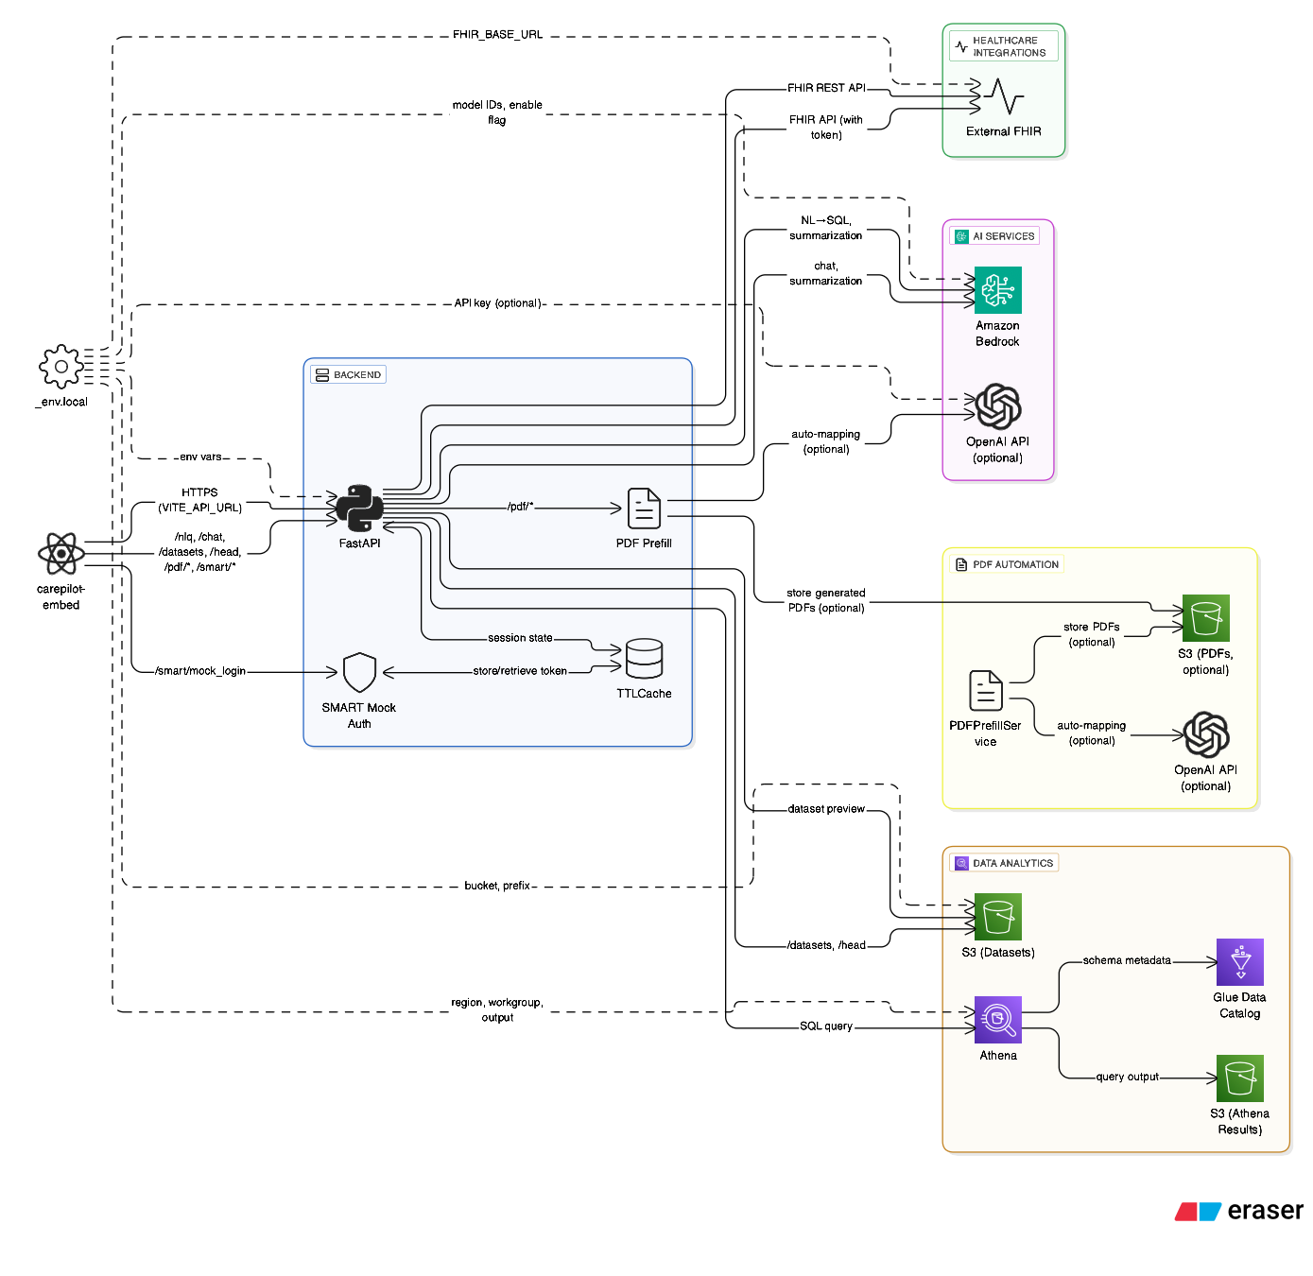

CarePilot

Slide 15

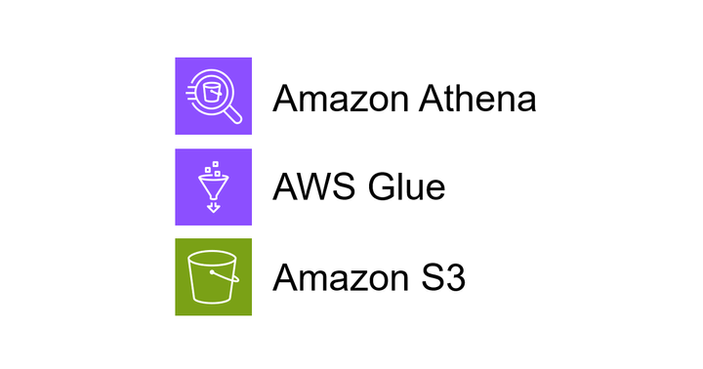


CarePilot
Tech Stack
SMART launch + FHIR reads with auth & pagination;
mock SMART for demo, production hooks for prod.
NL→SQL with allowlist & read-only guardrails, auto-repair, and instant charts
Lightweight prompts for reasoning and narrative; deterministic fallbacks when disabled to control cost

Slide 16

Thank You!

Slide 17


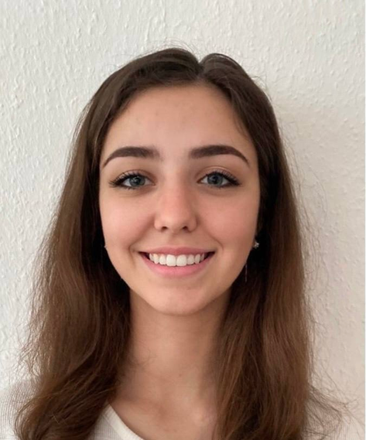


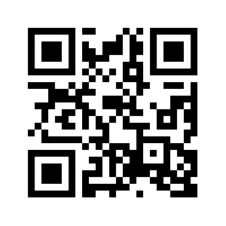


Our Team
Denis
Hoti
Veronika
Rybak
Ruslan
Tsibirov
Ali
Guliyev

